Slide 1

Ody Quraviharto
GAMS meeting
Batam – 16-Jun-2017

Slide 2
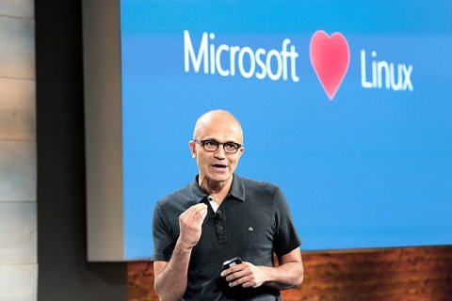

Slide 3
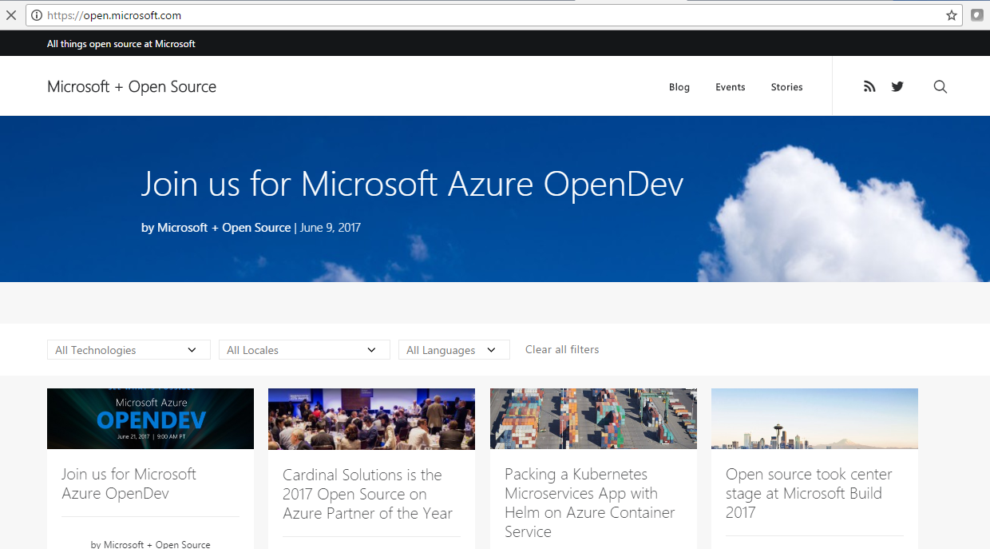

Slide 4
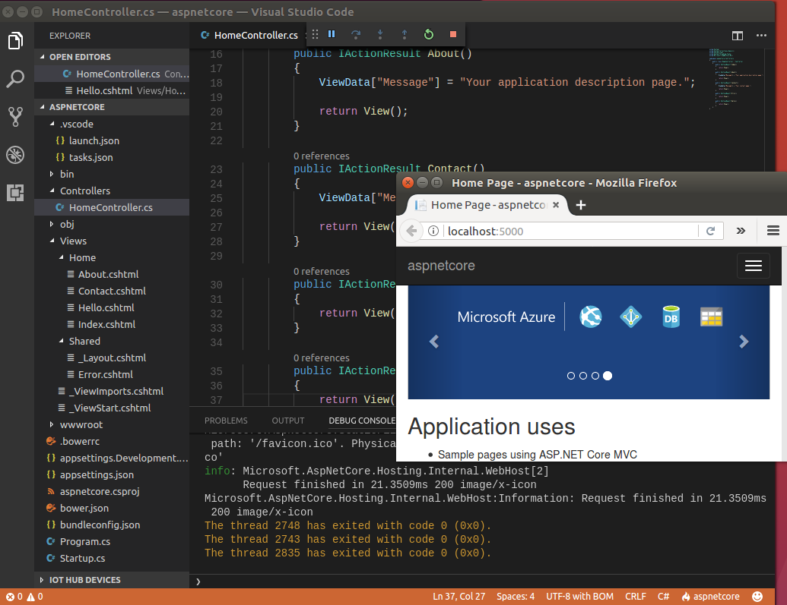
.NET FRAMEWORK on LINUX
LIVE DEMO

Slide 5
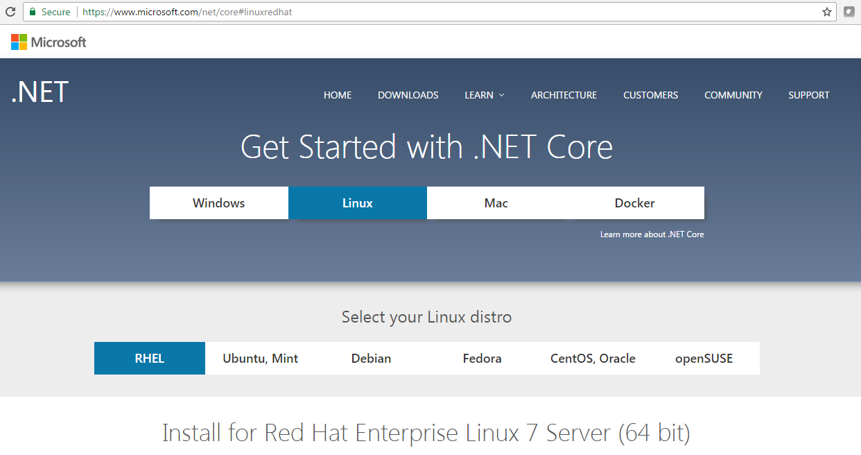

Slide 6
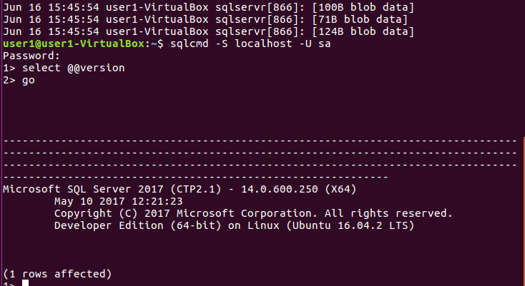
SQL server on Linux
LIVE DEMO

Slide 7
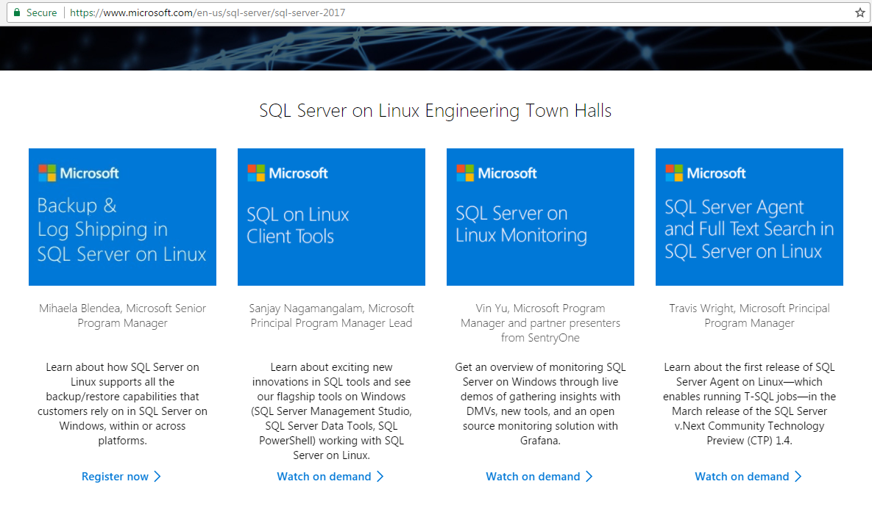

Slide 8
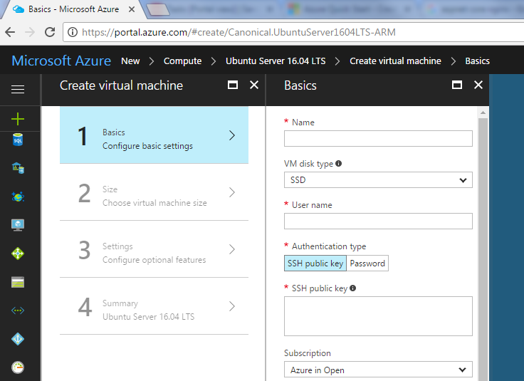
Linux on Microsoft Azure
Live Demo

Slide 9

Next August 2017: CONTAINER ☺

